Slide 1
DO NOT SHOW
Enterprise-scale for AKS delivery guide & resources
Speaker:
Partner
Primary Audience:
Customer ITDM, BDM, Cloud Architect
Impacted Audience:
Customer Sr. IT Pro/IT Operations/Application Owners/Influencers/Decisions Markers
Level:
L300
Usage guide:
This presentation provides instructions on how to deliver Enterprise-scale Landing Zones for AKS to customers. Use this deck to kick off the Enterprise-scale landing zones conversation and introduce other available resources.
Key contact for support:
Ayobami Ayodeji at aayodeji@microsoft.com
Additional supporting materials:
Enterprise-scale for AKS Overview Deck
Enterprise-scale for AKS Architecture guidance and reference implementation:

Slide 2
Enterprise-scale for AKS delivery guides and resources
Ayobami Ayodeji
08-09-2021

Slide 3
Goals and Scope of Enterprise-scale for AKS
An architectural guidance and reference implementation for AKS workloads in landing zone subscriptions
It enables rapid and effective development and operationalization of AKS workloads at scale that are aligned with Azure Roadmap and the Cloud Adoption Framework for Azure
Can be used by / for any customer who would like to deploy AKS workloads for production
Assumes that a platform foundation similar to ESLZ has already been setup that handles networking, security, identity and policy-based governance services
Helps architect everything that would get deployed into a subscription designated for AKS workloads

Slide 4
Critical Design Areas
Governance Disciplines and Security
Identity and Access Management
Development Options and DevOps
Network Topology and Connectivity
Operations Management and Monitoring
Business Continuity & Disaster Recovery
Notes:
<Key point>: Design areas are the critical components of Azure landing zones.
Remember the foundation we’re choosing? And how it depends on what house we are building?
Foundations for house construction have common attributes but have their own specific components—and the cloud environment is similar.
[Set up slide] These are the design components that all Azure landing zones must have.
[Go through each design area]
Thinking about how to deploy and how to manage landing zones, Deployment options and Operations baseline are critical to the Manage stage.
<Transition>: Let’s look at how we get started with Azure landing zones.

Slide 5
Enterprise-scale: Audience
Microsoft
Customer Success
Customer Engineers
Cloud Solution Architects
Customer Field Roles
Partner/MCS/Fast Track
Technical Lead
Customer Leads*
Arch Lead/Chief Architect
Network (NetOps)
Identity and Access Management (IAM)
Systems (SysOps: OS, DB)
Operations and Management
Security (SecOps)
DevOps and Automation
Application Architecture
Site Reliability Engineers
*Customer may bring additional SMEs where and when required.
Notes:
Before selecting a date for the design workshop confirm the right business decision makers and teams are involved to enable the cloud operating model for Enterprise-scale.

Slide 6


Enterprise-Scale: Workshop Objective
Review
Deep understanding of customer environment, workloads, and technical constraints
Design
Target DC architecture is designed that is aligned with Enterprise-scale and in compliance with customer requirements
Success Criteria
All technical requirements to build a AKS ESLZ agreed and documented
Success Criteria
Target AKS ESLZ architecture design agreed and documented.
Notes:
The workshop is a time of collaboration and team cooperation to build customer confidence in the cloud operating model that will accelerate production adoption.
Review- Customers have concerns about cloud architecture and want to know with confidence the Azure services they should implement that will meet business and technical requirements. A deep understanding of the customer environment and architectural motivations is required to reduce adoption friction. Ask questions to make sure we understand the customers motivations. It also important to ask questions that confirm what the customers level of knowledge is about Azure Architecture best practices and patterns.
While reviewing each design guideline confirm the architectural decisions made and document them while confirming they align with the Enterprise-scale principles. Any deviation from Enterprise-scale design principles or design guidelines recommendations should be documented and communicated so the customer understands the effects of the deviation.
Success criteria should focus on completing the implementation of Enterprise-scale landing zone with a production workload identified by the customer in the workshop. The customer maybe familiar with Azure and a full week for the workshop may not be required or you may not need to cover every topic in the example agenda provided. Meet the customer momentum and pull in extended team members who can go as deep as necessary in order to complete the landing zone design.

Slide 7

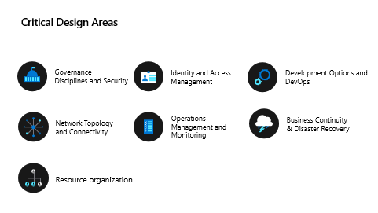
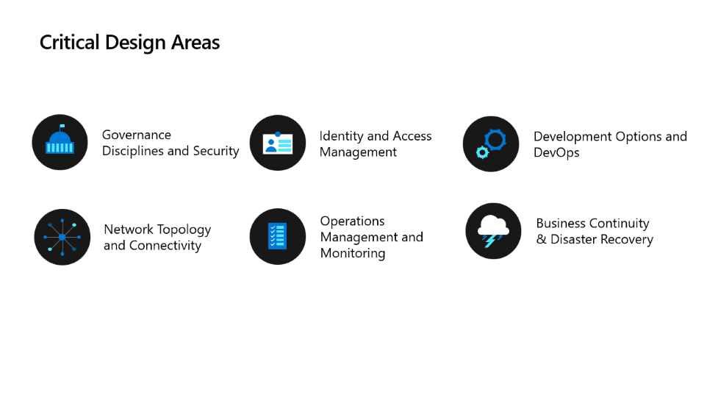
Enterprise-scale Delivery
Start with the overview deck
Use the ES for AKS Architecture and design guidance documentation to guide the conversation
Capture decisions mutually agreed upon with customer. Here is an example template that can be used.
Capture trade-offs; make customer aware of the implications in the same document
Provide positive and negative feedback using the Feedback Form Hand over the documented decisions to the deployment team (customer or partner) and update the current milestones with estimated time of execution
Use reference implementation to accelerate time to production
Notes:
Here are some quick tips on how to use the example template:
For area-specific reviews: use the filter in "Design Area" to focus on certain rows during a session
For reviews with limited time: use the filter in "Severity" to focus only on High priority items
For project checkins, verify the "Status" (Not verified, Open, Fulfilled) and the "Owner"
The design principles and critical design guidelines have been used with customers to implement success and the Enterprise-scale Architecture aligns to the Azure roadmaps. If a customer wants to deviate from the principles or critical design area explain our methodology and confirm they understand our positioning. In the end capture any trade offs or deviations a customer makes and document the implications.

Slide 8
Enterprise-scale for AKS: Example Workshop Agenda
 | DAY 1 | DAY 2 | DAY 3
 | Enterprise-scale Architecture Ò AKS Landing Zone | Networking & Management | Security and Devops
9:00 | Introductions: Goals and objective | Connectivity to Azure - ER, NGF/WAF, Network, DNS Ingress/Egress, Segmentation | Encryption and Key Management
9:30 | Use overview deck
10:00 | What-must-be-true for the “Enterprise-scale” or similar |  | Policy Driven Governance, Service Whitelisting Framework
10:30 |  | Connectivity to Azure PaaS Services, Inbound & Outbound Internet Connectivity
11:00 | Application Portfolio Review |  | Business Continuity & Disaster Recovery
11:30
12:00
12:30 | Lunch
13:00
13:30 | ES for AKS Principles, Critical Design Areas and Operating model | Application Management and Monitoring | HA/BCDR
14:00 |  |  | Development Options and DevOps: Capability Review
14:30 | Identity & Access Management, Resource Organization
15:00 |  |  | "Monday Morning" Implementation: Accelerators/Blockers and Next Steps (Use Reference Implementation)
15:30 |  | Governance Disciplines and Security Review
16:00
16:30 | Network Topology & Connectivity Review
17:00
Notes:
The example agenda for an Enterprise-scale for AKS workshop covers all the principles and critical design area topics to ensure successful landing zone design. Some customers may exhibit maturity in certain areas and may not need a session for each topic. Document the recommendations and the decisions the customer has already made so the complete vision for the Azure landing zone is captured in the design output. Here is an example template that can be used for documentation: AKS construction set workshop checklist.xlsx (sharepoint.com)

Slide 9
Enterprise-Scale for AKS | Resources
Customer:
Start with Cloud Adoption Framework Enterprise-Scale Landing Zone
Enterprise-Scale for AKS Architecture and Design Guidance
Overview Deck Enterprise-scale for AKS
Enterprise-Scale for AKS Reference Implementation
Enterprise-Scale for AKS Decision Collection Excel template

